Slide 1
UNIT II
THEORY OF PRODUCTION
&
COST ANALYSIS

Slide 2
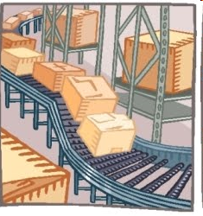
What is production???
Production is an activity that transforms inputs into output.
It can be defined as the process of creation of utility.

Slide 3
PRODUCTION FUNCTION
Production Function is purely a technological relationship which expresses the relation between output of a good and the different combinations of inputs used in its production.
It shows the maximum production obtained from a given set of inputs with a given state of technology.

Slide 4
MATHEMATICAL EXPRESSION
Production Function can be expressed mathematically in the form of an equation.
Q = f (L1, L2, C, O, T)
Where, Q= Quantity of production
f = function C = Capital
L1= Land O = Organization
L2= Labour T = Technology

Slide 5
There are two methods by which output can be raised:
Changing some inputs
Changing all inputs
Changing some inputs Law of Variable proportions
(or) Law of Diminishing Returns
Changing all inputs Returns to Scale

Slide 6
LAW OF VARIABLE PROPORTIONS
Law of Variable proportions refers to the short run.
It explains the changes in output when a factor of production is varied while keeping other factors constant.
It is also called “ Law of Diminishing returns”

Slide 7
ASSUMPTIONS OF THE LAW
The state of technology remains constant. If there is any improvement in technology, the average and marginal out put will not decrease but increase.
Only one factor of input is made variable and other factors are kept constant. This law does not apply to those cases where the factors must be used in rigidly fixed proportions.
All units of the variable factors are homogenous.

Slide 8
THREE STAGES OF THE LAW
The behavior of Output when varying quantity of one factor is combined with a fixed quantity of another factor can be divided into three district stages.

Slide 9
EXAMPLE:
Labour | TP | AP | MP | Stages
0 | 0 | 0 | 0 | STAGE I
1 | 5 | 5 | 5
2 | 12 | 6 | 7
3 | 18 | 6 | 6 | STAGE II
4 | 20 | 5 | 2
5 | 20 | 4 | 0
6 | 18 | 3 | -2 | STAGE III
7 | 14 | 2 | -4

Slide 10
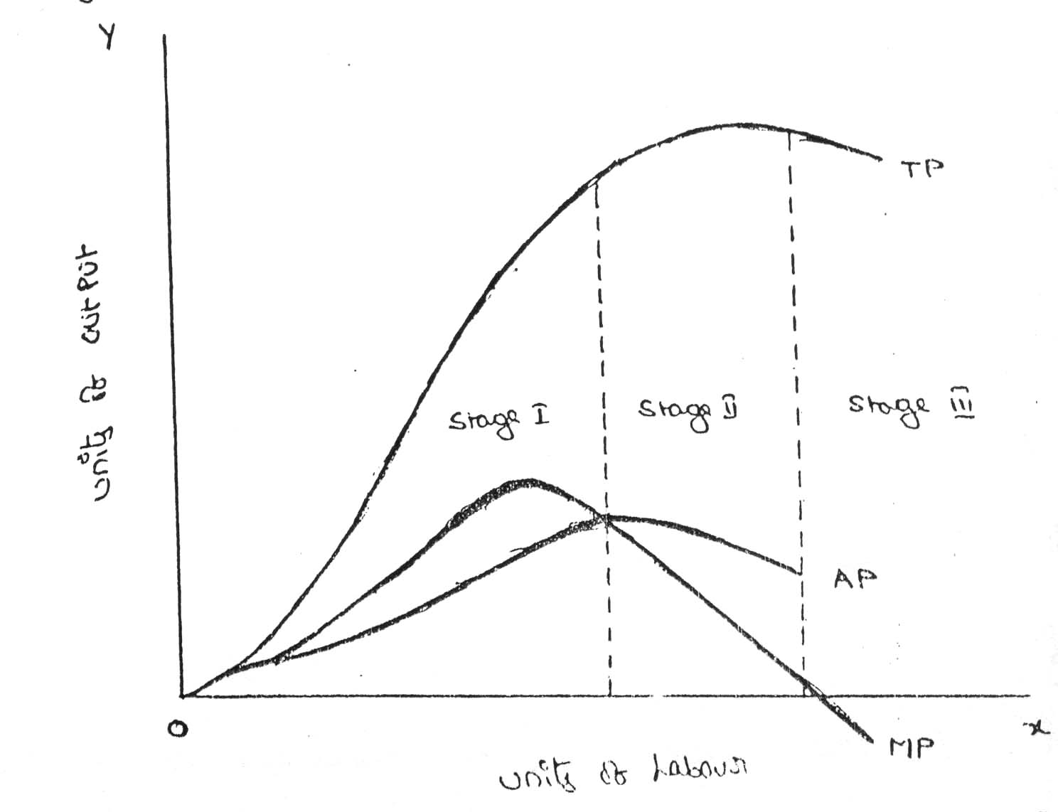

Slide 11
Production function with Two Variable Inputs-ISOQUANT
An Isoquant is a curve representing the various combinations of two inputs that produce the same amount of output.
An isoquant is also known as iso-product curve, equal – product curve or production indifference curve.

Slide 12
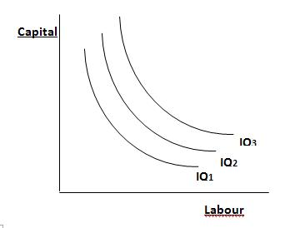

Slide 13
Combinations | Capital(in lakhs) | No. of Labourers
A | 1 | 20
B | 2 | 15
C | 3 | 11
D | 4 | 8
E | 5 | 6
F | 6 | 5

Slide 14
Properties of isoquants
An Isoquant is downward sloping to the right
Higher iso-quant represents larger output
No two iso-quants intersect or touch each other
Iso-quants are convex to the origin.

Slide 15
MARGINAL RATE OF TECHNICAL SUBSTITUTION
MRTS refers to the rate at which one input factor is substituted with the other to attain a given level of output.
Combinations | Capital(in lakhs) | No. of Labourers | Marginal Rate of Technical Substitution(MRTS)
A | 1 | 20 | -
B | 2 | 15 | 5:1
C | 3 | 11 | 4:1
D | 4 | 8 | 3:1
E | 5 | 6 | 2:1
F | 6 | 5 | 1:1

Slide 16
ISOCOSTS
Iso costs refers to that cost curve that represents the combination of inputs that will cost the producer the same amount of money.

Slide 17
Capital
ISOCOSTS
IC 3
IC 2
IC 1
Labour

Slide 18
LEAST COST COMBINATION OF INPUTS
Where the slope of isoquant is equal to that of isocost, there lies the lowest point of cost of production.
IC 3
Capital
IC 2
EXPANSION PATH
IC 1
IQ3
IQ2
IQ1
Labour

Slide 19
COBB DOUGLAS PRODUCTION FUNCTION
Cobb and Douglas put forth a production function relating output to labour and capital inputs.

Slide 20
Cobb – Douglas production function takes the following mathematical form:
P= b LªC^{1-a}
where, P= Total Output
L = index of employment of labour in manufacturing
C = index of fixed capital in manufacturing
a and 1-a and b are elasticities of production

Slide 21
Returns to scale
Economists use the phrase, “Returns to Scale” to describe the relationship between output behavior in the long run in relation to the variations of factor inputs.
In the long run, adjustments can be made among the different factors and therefore, all factors become variable during this period.

Slide 22
Returns to scale are of three types:
Increasing Returns to Scale
Constant Returns to Scale
Decreasing Returns to Scale

Slide 23
THE LAWS OF RETURNS TO SCALE
Capital (in units) | Labour (in units) | Percentage of Increase in both inputs | Output (in units) | Percentage of Increase in output | Laws Applicable
1 | 3 | - | 50 | -
2 | 6 | 100 | 120 | 140 | Law of increasing returns to scale
4 | 12 | 100 | 240 | 100 | Law of constant returns to scale
8 | 24 | 100 | 360 | 50 | Law of decreasing returns to scale

Slide 24
Increasing returns to scale
Increasing returns to scale arise when a given percentage increase in inputs leads to a greater percentage increase in the resultant output.
Hence, the total product increases at an increasing rate.

Slide 25
constant returns to scale
Constant returns to scale is a stage where the given percentage increase in inputs will be equal to the percentage increase in the resultant output.

Slide 26
decreasing returns to scale
Decreasing returns to scale will occur when a firm continues to expand its size beyond a particular point.
Decreasing returns to scale operate when the percentage increase in output is less than the percentage increase in input.

Slide 27
ECONOMIES OF SCALE
The advantages of large scale production are called Economies of Scale.
Internal Economies
External Economies

Slide 28
INTERNAL ECONOMIES
Internal Economies are those economies which are open to an individual firm when its size expands.
Technical Economies
Marketing Economies
Managerial Economies
Financial Economies
Risk Bearing Economies

Slide 29
EXTERNAL ECONOMIES
When the number of firms producing the same commodity increase in a particular area, all the firms enjoy certain advantages which are called External Economies.
Economies of Concentration
Economies of Information
Economies of Specialization
Economies of Welfare

Slide 30
Both internal and external economies increase the output and reduce the cost of production.
But, these economies arise only up to a particular limit beyond which, diseconomies emerge.

Slide 31
COST CONCEPTS
Study of costs is essential for making the competing production plans.
Production decisions are not possible without respective cost considerations.
Productive resources are scarce with any firm and have alternative uses
The firm have to analyze these sacrifices.

Slide 32
OPPORTUNITY COST
Opportunity cost is concerned with the cost of forgone opportunities.
It focuses attention on the net revenue that could be generated in the next best use of a scarce input.

Slide 33
ACTUAL OR OUTLAY COST
Actual costs are the costs which the firm incurs while producing or acquiring a good or a service like the cost on material, labour, rent, interest etc.
They are also called Acquisition costs or absolute costs.

Slide 34
EXPLICIT COSTS VS IMPLICIT COSTS
Explicit costs are those expenses which are actually paid by the firm. These costs appear in the accounting records of the firm. Example: rent to the landlord, interest on capital etc…
Implicit costs or imputed costs are theoretical costs in the sense that they go unrecognized by the accounting system. These costs are the earnings of those employed resources which belong to the owner himself. Example: Interest on own capital, rent of own premises and so forth.

Slide 35
INCREMENTAL COSTS VS SUNK COSTS
Incremental costs are the additions to costs resulting from a change in the nature and level of business activity. They are also called avoidable or escapable costs. It is also called Differential cost.
Sunk costs are those that do not change by varying the nature or level of business activity. These cost have already been committed or spent in the past. They do not affect the current production.

Slide 36
BOOK COSTS VS OUT OF POCKET COSTS
Out of pocket costs are those expenses which are current cash payments to outsiders. Example : Purchase of Raw Materials or payment of salaries , utility expenses etc. It is also called explicit cost.
Book costs are those business costs which do not involve any cash payments but for them a provision is made in the books of account to include them in profit and loss accounts and take tax advantages.Example:Depreciation

Slide 37
DIRECT COSTS VS INDIRECT COSTS
Direct or traceable or assignable costs are the ones that have direct relationship with a unit of operation.
Indirect costs are those whose course cannot be easily and definitely traced to a plant, a product, a process or a department. Ex: Accounting and legal expenses, Administrative salaries.

Slide 38
CONTROLLABLE COSTS VS NON CONTROLLABLE COSTS
Controllable costs are those costs which are capable of being controlled or regulated by executive vigilance and so can be used for assessing executive efficiency.
Non Controllable costs are those which cannot be subjected to administrative control and supervision.

Slide 39
REPLACEMENT COSTS VS HISTORICAL OR ORIGINAL COSTS
Historical cost of an asset states the cost of plant, equipment and materials at the price paid originally for them, while the replacement cost states the cost that the firm would have to incur if it wants to replace or acquire the same assets now..

Slide 40
URGENT COSTS VS POSTPONABLE COSTS
Urgent costs are those that must be incurred so that the operations of the firm continue.
Those costs whose postponement does not affect the operational efficiency of the firm, are known as postponable costs

Slide 41
FIXED COSTS VS VARIABLE COSTS
Fixed costs or constant costs are that part of the total cost of the firm which does not vary with output.
Variable costs are directly dependent on the volume of output or service.

Slide 42
SHORT RUN COSTS VS LONG RUN COSTS
In the short run some inputs are fixed while others are variable. Short run costs are therefore both fixed and variable.
In the long run all costs are variable.

Slide 43
Semi-Fixed or Semi-Variable Costs
Semi-Fixed or Semi-Variable Costs :It refers to such costs that are fixed to some extent beyond which they are variable.

Slide 44
TC, AC AND MC
Total cost represents the money value of the total resources required for production of goods and services by the firm.
Average cost is the cost per unit of output, assuming that production of each unit of output incurs the same cost.
Marginal Cost: It refers to the additional cost incurred for producing an additional unit. This change is due to a change in the level of output.

Slide 45
SHORT RUN COST FUNCTION
If the firm wants to expand its output, it is possible in the short run only by a change in the rate of utilization of the assets.
TC = TFC + TVC

Slide 46
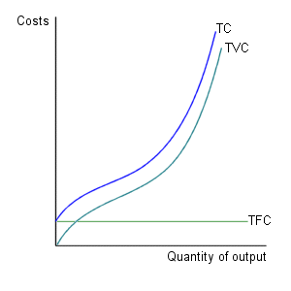
SHORT RUN COST CURVE

Slide 47
Q | TFC | TVC | TC | AFC | AVC | ATC | MC
0 | 1000 | 0
10 | 1000 | 400
20 | 1000 | 700
30 | 1000 | 930
40 | 1000 | 1100
50 | 1000 | 1400
60 | 1000 | 1900
70 | 1000 | 2500

Slide 48
Q | TFC | TVC | TC | AFC | AVC | ATC | MC
0 | 1000 | 0 | 1000 | - | - | - | -
10 | 1000 | 400 | 1400 | 100 | 40 | 140 | 40
20 | 1000 | 700 | 1700 | 50 | 35 | 85 | 30
30 | 1000 | 930 | 1930 | 33.3 | 31 | 64.3 | 23
40 | 1000 | 1100 | 2100 | 25 | 27.5 | 52.5 | 17
50 | 1000 | 1400 | 2400 | 20 | 28 | 48 | 30
60 | 1000 | 1900 | 2900 | 16.7 | 31.7 | 48.4 | 50
70 | 1000 | 2500 | 3500 | 14.3 | 35.7 | 50 | 60

Slide 49
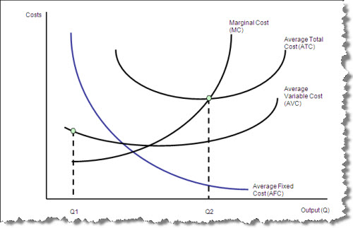
SHORT RUN COST CURVE

Slide 50
PROPERTIES OF SRCC
MC<AVC, AVC declines
MC=AVC, AVC is at its minimum
MC>AVC, AVC is rising
The same relationship holds between MC and ATC also

Slide 51
long RUN COST CURVE
In the long run, by definition, all factors are variable so that the entrepreneur has before him a number of alternative plant sizes and levels of output which he can adopt.
The long run cost curve is also called Planning curve.

Slide 52
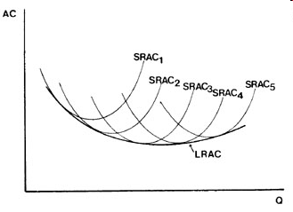
long RUN COST CURVE

Slide 53
BREAK EVEN ANALYSIS
Since profit earning is one of the most important objectives of any company, profit cannot be left to chance or luck.
Break Even Analysis reveals the relation ship between volume and cost of production on the one hand, and the revenue and profits obtained from sales on the other.

Slide 54
According to Martz, curry and Frank, “A Break Even Analysis indicates at what level cost and revenue are in equilibrium.”
BREAK EVEN POINT:
It is that point of activity where total revenues and total expenses are equal. It is the point of Zero Profit.
Hence, it is a point where losses cease to occur while profits have not yet begun. It is also called “ No Profit, No loss point.”

Slide 55
In case the firm produces and sells less than what is suggested by the break even point, it would incur losses; while if it produces and sells more than the level of break even point, it makes profits.

Slide 56
BREAK EVEN CHART
It shows the extent of profit or loss to the firm at different levels of the activity.

Slide 57
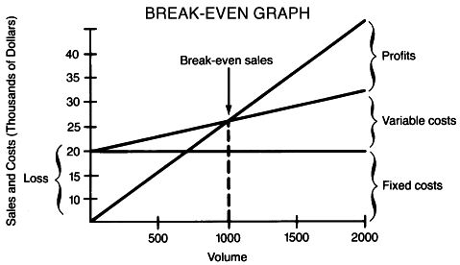

Slide 58
DETERMINATION OF BREAK EVEN POINT
SP = FC + VC + profit
SP – VC = FC + Profit
= Contribution
So, Contribution per Unit = SP p.u – VC p.u
BREAK EVEN POINT = FC (in units) Contribution p.u

Slide 59
CONTRIBUTION MARGIN
Contribution Margin is the difference between receipts and variable expenses.
Ex: If a product is sold at Rs.10 per unit and its variable expenses are Rs.4.
This implies that each unit of the product recovers Rs.6 over and above its variable expenses of Rs.4.
Thus, Rs.6 is contribution to the recovery of fixed expenses or profit.

Slide 60
DETERMINATION OF BREAK EVEN POINT
BREAK EVEN = FC POINT (in value) Contribution margin
ratio
Where, CMR = CM p. u
SP p. u

Slide 61
PROBLEM 1
A firm has a fixed cost of Rs. 10,000; selling price per unit is Rs.5 and Variable cost per unit is Rs. 3. Determine BEP in terms of Volume and sales value.

Slide 62
PROBLEM 2
A retailer plans to sell a baby elephant toy at a local fair. His purchase price of this toy is Rs. 7 per piece with the privilege of returning the unsold toys. The booth rent at the fair is Rs. 2,500 payable in advance. The selling price of the toy is fixed at Rs. 12 per piece.
Find out the number of toys which must be sold to break even and also the break even sales volume.

Slide 63
MARGIN OF SAFETY
Margin of Safety is the excess of budgeted or actual sales over the break even sales volume.
Thus, Margin of Safety represents the difference between the actual sales volume and the sales volume suggested by the break even point.

Slide 64
PROBLEM 3
If the fixed costs of a company are Rs. 60,000, the variable costs Rs.10 p.u of output and the selling price is Rs.20 p.u, find the break even point.
If the company sells 10,000 units of the product, Find the safety margin of the company.

Slide 65
PROBLEM 4
Srikanth Enterprises deals in the supply of hardware parts of computer. The following cost data is available for two successive periods:
YEAR 1 YEAR 2
SALES 50000 120000
FC 10000 20000
VC 30000 60000
Determine a) BEP b) MOS

Slide 66
DETERMINATION OF BREAK EVEN POINT WHEN PER UNIT DATA IS NOT AVAILABLE
BREAK EVEN = FC POINT (in value) PV Ratio
Where, PV ratio = Profit Volume ratio
= Contribution
Sales

Slide 67
MOS = Net profit
P/V Ratio
Where, PV ratio = Profit Volume ratio
= Contribution
Sales

Slide 68
APPLICATION OF BEA
Make or Buy Decision
Choosing a product mix when there is a limiting factor
Drop or add Decisions

Slide 69
SIGNIFICANCE OF BEA
To ascertain the profit on a particular level of sales volume
To calculate sales required to earn a particular level of profit
Choosing a product mix when there is a limiting factor
to decide whether to add a particular product to the existing product line
make or buy decision

Slide 70
LIMITATIONS
All costs cannot be classified into fixed and variable costs
It is not efficient enough in the case of multi product firms
It holds good in the short run only.
Volatile business conditions make BEP unstable.
Various assumptions in the chart.

Slide 71
